Slide 1
ORB-SLAM
Jaeman Han

Slide 2
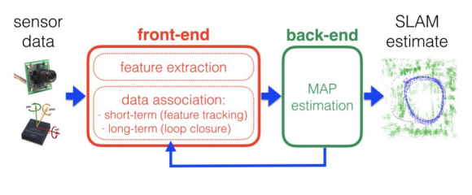
Introduction

Slide 3
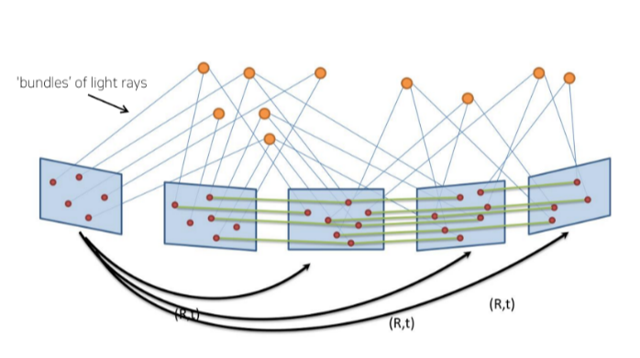
Introduction
BA(Bundle Adjustment)
다수의 프레임에 존재하는 Visual keypoint 들의 위치 (i.e. 2D pixel location)를 기반으로 추정할 수 있는
3D landmark position과 카메라 프레임간의 3D relative motion을 동시에 최적화하는 과정
Reprojection error를 보정하기 위해 최적화를 진행
Extremely time consuming.

Slide 4
Introduction
BA(Bundle Adjustment)
Corresponding observations of scene features (map points) among a subset of selected frames (keyframes)
As complexity grows with the number of keyframes, their selection should avoid unnecessary redundancy.
A strong network configuration of keyframes and points to produce accurate results, that is, a well spread set of keyframes observing points with significant parallax and with plenty of loop closure matches
The ability to perform fast global optimizations (e.g., pose graph) to close loops in real time.

Slide 5
Introduction
PTAM(Parallel Tracking and Mapping)
We propose to split tracking and mapping into two separate tasks, processed in parallel threads
one thread deals with the task of robustly tracking erratic hand-held motion
the other produces a 3D map of point features from previously observed video frames.
Problem
the system is not designed to close large loops in the SLAM sense.
lack of loop closing and adequate handling of occlusions
low invariance to viewpoint of the relocalization
the need of human intervention for map bootstrapping

Slide 6
ORB-SLAM
Contribution
Use of the same features for all tasks: tracking, mapping, relocalization, and loop closing.
We use ORB features , which allow real-time performance without GPUs, providing good invariance to changes in viewpoint and illumination.
Real-time loop closing based on the optimization of a pose graph that we call the Essential Graph.
Real-time camera relocalization with significant invariance to viewpoint and illumination. This allows recovery from tracking failure and also enhances map reuse.
A new automatic and robust initialization procedure based on model selection that permits to create an initial map of planar and nonplanar scenes.
A survival of the fittest approach to map point and keyframe selection. This policy improves tracking robustness and enhances lifelong operation because redundant keyframes are discarded

Slide 7
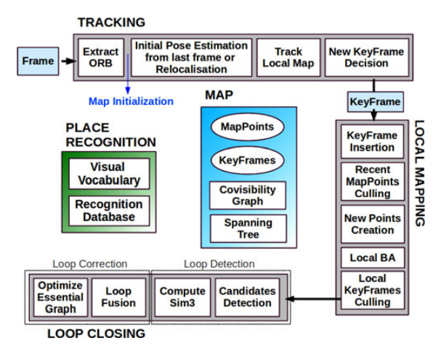
SYSTEM OVERVIEW
Feature-based
Monocular
Loop closing, relocalization and map reuse
Three threads running in parallel
Tracking
Local Mapping
Loop Closing

Slide 8
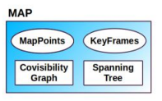
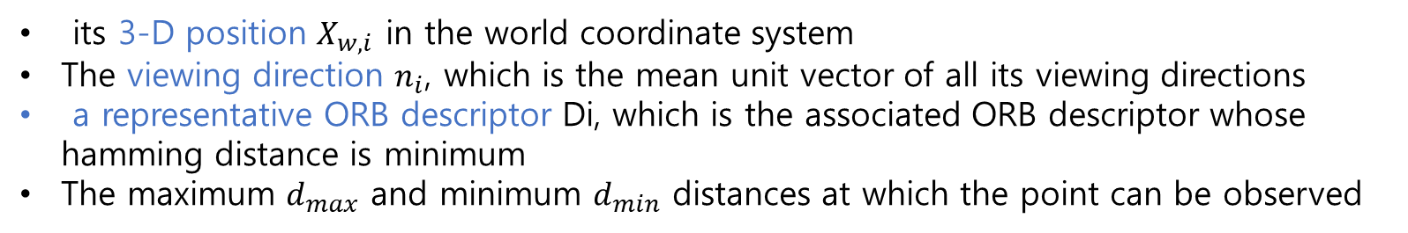
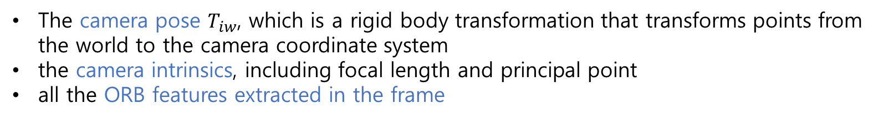
ORB SLAM: MAP
Each map point $p_{i}$ stores :
its 3-D position $X_{w,i}$ in the world coordinate system
The viewing direction $n_{i}$, which is the mean unit vector of all its viewing directions
a representative ORB descriptor Di, which is the associated ORB descriptor whose hamming distance is minimum
The maximum $d_{max}$ and minimum $d_{min}$ distances at which the point can be observed
Each keyframe $K_{i}$ stores :
The camera pose $T_{iw}$, which is a rigid body transformation that transforms points from the world to the camera coordinate system
the camera intrinsics, including focal length and principal point
all the ORB features extracted in the frame

Slide 9
ORB SLAM: MAP
Map points and keyframes are created, while a later very exigent culling mechanism is in charge of detecting redundant keyframes and wrongly matched or not trackable map points.
This permits a flexible map expansion during exploration, which boost tracking robustness under hard conditions (e.g., rotations, fast movements)
our maps contain very few outliers compared with PTAM

Slide 10
Covisibility Graph and Essential Graph
Covisibility Graph
Each node is a keyframe, and an edge between two keyframes exists
they share observations of the same map points (at least 15)->edge
the weight θ of the edge the number of common map points.
In order to correct a loop, we perform a pose graph optimization
Essential Graph
retains all the nodes (keyframes), but minimum edges
preserving a strong network that yields accurate results
The system builds incrementally a spanning tree
subgraph of the covisibility graph

Slide 11
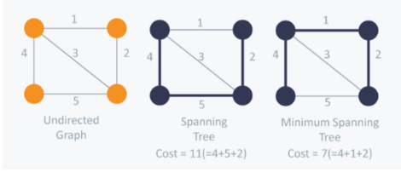
Spanning Tree

Slide 12
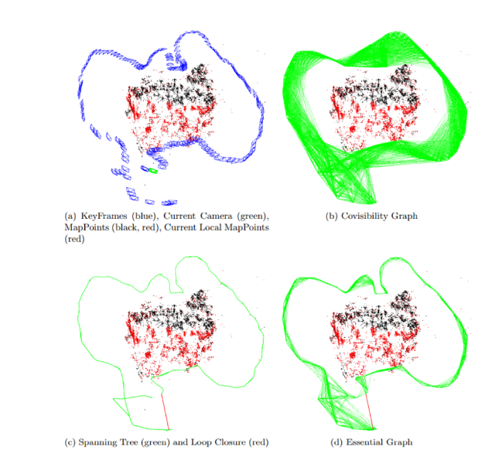
Covisibility Graph and Essential Graph

Slide 13
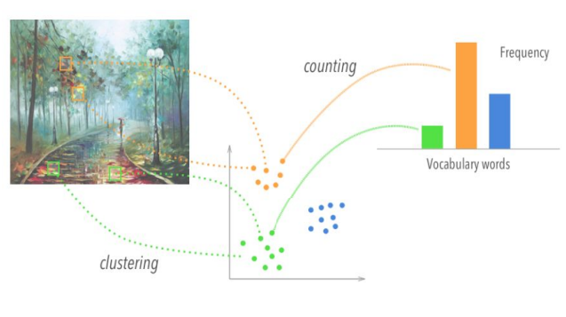
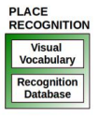
Bags of Words Place Recognition
Visual Vocabulary
Offline vocabulary of ORB descriptors extracted from a large set of images

Slide 14
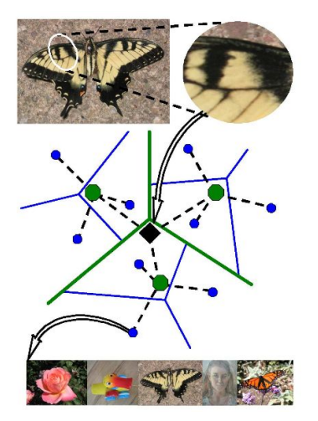
Bags of Words Place Recognition
Recognition Database
Database built incrementally, which stores for each visual word in the vocabulary, in which keyframes it has been seen.
Vocabulary tree using hierarchical k--‐means clustering

Slide 15
ORB SLAM에서의 Bag of Words
-영상에서 추출한 ORB feature로부터 code 및 codebook 생성
-ORB SLAM을 이루는 3가지 시스템인 Tracking, Local Mapping, Loop Closing, 전반에 걸처 사용
1. Tracking
- Traking과정에서 lost가 발생한 경우, 새로 들어오는 영상의 ORB feature를 이전에 생성된 keyframe의 map point로 구성된 bag of words와 비교하는 과정인 global relocalization을 거친다.
이후 충분히 유효한 값이 나오면 tracking을 이어서 실시한다
2. Local Mapping
- 새로운 keyframe이 생성되는 경우 keyframe을 나타내는 bag of words를 계산해 새로운 map point의 triangulation의 계산을 돕는다.
​
3. Loop Closing
- 새로운 keyfream이 Local Mapping 과정에서 만들어진 keyframe의 bag of words 내의 값과 유사하다면 이전에 지나온 장소라고 판단해 Loop Closing이 일어날 수 있는 후보로 분류한다

Slide 16
AUTOMATIC MAP INITIALIZATION
The goal of the map initialization is to compute the relative pose between two frames to triangulate an initial set of map points.
We propose to compute in parallel two geometrical models: a homography assuming a planar scene and a fundamental matrix assuming a nonplanar scene.
a heuristic to select a model and try to recover the relative pose

Slide 17

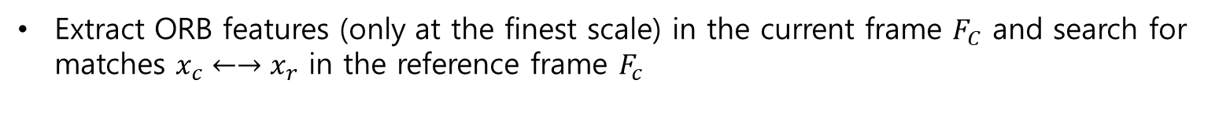
algorithm
Find initial correspondences
Extract ORB features (only at the finest scale) in the current frame $F_{C}$ and search for matches $x_{c}←→x_{r}$ in the reference frame $F_{c}$
2. Parallel computation of the two models
Compute in parallel threads a homography $H_{cr}$ and a fundamental matrix $F_{cr}$

Slide 18
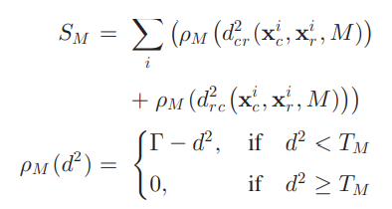
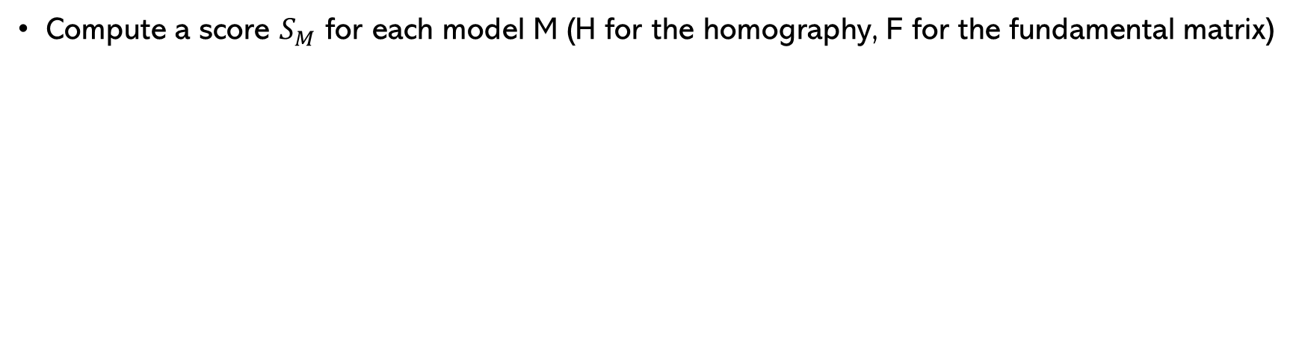
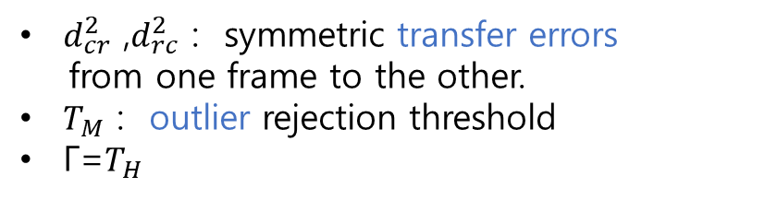
algorithm
Compute a score $S_{M}$ for each model M (H for the homography, F for the fundamental matrix)
$d_{cr}^{2}$ ,$d_{rc}^{2}$ : symmetric transfer errors
from one frame to the other.
$T_{M}$ : outlier rejection threshold
Γ=$T_{H}$
If no model could be found (not enough inliers), we restart the process again from step 1.

Slide 19

Model selection
If the scene is planar →using homography
a fundamental matrix is not well constrained
recover the motion from the fundamental matrix would yield wrong results
We should select the homography as the reconstruction method will correctly initialize from a plane
it will detect the low parallax case and refuse the initialization
if RH > 0.45, which adequately captures the planar and low parallax cases.
Otherwise, we select the fundamental matrix.

Slide 20

Motion and structure from motion recovery
2차원 이미지 sequence로 부터 3d structure를 recovery하는 과정
We propose to directly triangulate the eight solutions
In the case of the fundamental matrix, we convert it in an essential matrix using the calibration matrix K as

Slide 21
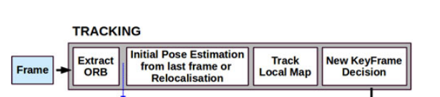
Tracking
Localize the camera with every frame and decide when to insert a new keyframe.

Slide 22
Tracking: ORB Extraction
Extremely fast to compute than SIFT or SURF

Slide 23
Tracking: Initial Pose Estimation or Relocalization
Pose Estimation From last Frame
constant velocity motion model to predict the camera pose
a guided search of the map points observed in the last frame
Pose optimization using Motion-only BA
Pose Estimation via Global Relocalization (if tracking lost)
Convert the frame into bag of words
query the recognition database for global relocalization
Outlier rejection: RANSAC
PnP to get pose
Pose optimization

Slide 24
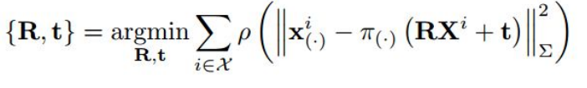
Tracking: Initial Pose Estimation or Relocalization
Pose Optimization using Motion-only bundle adjustment:
Optimize camera Rotation R and position t
Minimizing error between matched 3D points in world coordinates and key points
Levenberg-Marquadt for non-linear optimization

Slide 25
Tracking: Track Local Map
Once we have an estimation of the camera pose and an initial set of feature matches
we can project the map into the frame and search more map point correspondences.
the complexity in large maps, project a local map
local map
the set of keyframes K1 : share map points with the current frame
set K2 with neighbors to the keyframes K1 ( in the covisibility graph)
a reference keyframe Kref ∈ K1, shares most map points with current frame.

Slide 26
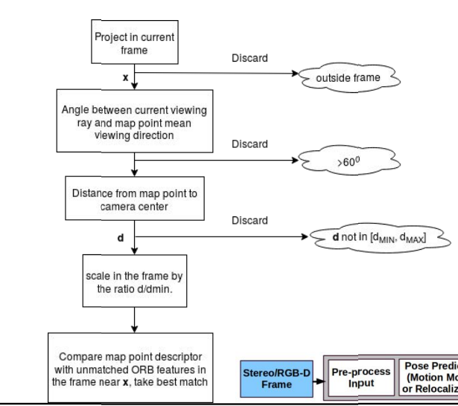
Tracking: Track Local Map
The camera pose is finally optimized

Slide 27
Tracking: New Keyframe Decision
1) More than 20 frames must have passed from the last global relocalization.
2) Local mapping is idle, or more than 20 frames have passed from last keyframe insertion.
3) Current frame tracks at least 50 points.
4) Current frame tracks less than 90% points than Kref .

Slide 28
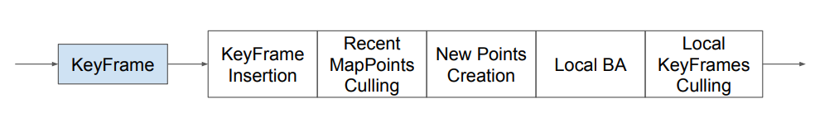
Local Mapping
Process new keyframes and performs local BA to optimize the map points and the poses of the keyframes

Slide 29
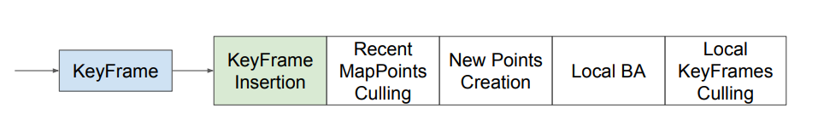
Local Mapping: Keyframe Insertion
Update the covisibility graph
Add new node and update edges
Update the spanning tree in essential graph
Link with the keyframe with most shared points
Compute the bags of words representation
Help triangulating new points

Slide 30
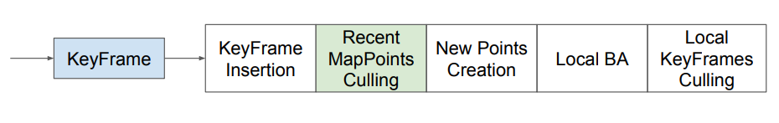
Local Mapping: Recent Map Points Culling
Removal test after creation
Can be found in more than 25% of the predicted visible frames
Can be observed in at least three keyframes
Keyframe culling
local BA discards outlier observations.
This policy makes our map contain very few outliers

Slide 31
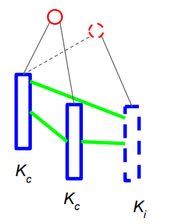

Local Mapping: New Map Point Creation
New keyframe $K_{i}$ and connected keyframes $K_{c}$
in the covisibility graph
For unmatched ORB in $K_{i}$ , search match in $K_{c}$
Determine new map point properties
Mean unit vector of all its viewing directions
Representative descriptor
Observation distance

Slide 32
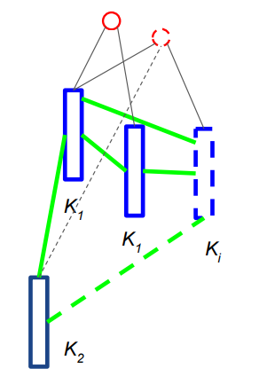
Local Mapping: New Map Point Creation
Connected keyframes K1 in covisibility graph
Neighbor keyframes K2 to the keyframes K1
Project new map points to K1 and K2
Update covisibility graph

Slide 33
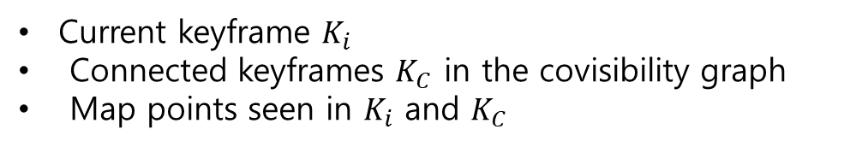
Local Mapping: Local Bundle Adjustment
Optimize poses and map points
Current keyframe $K_{i}$
Connected keyframes $K_{C}$ in the covisibility graph
Map points seen in $K_{i}$ and $K_{C}$
Fixed constraint
Keyframes with same map points but not connected to
Discard map points outliers and modify poses and map point coordinates

Slide 34
Local Mapping: Local Keyframe Culling
the local mapping tries to delete redundant keyframes
Reduce BA complexity and limit the number of keyframes
Culling policy
Any keyframe in Kc whose 90% of the map points can be seen in at least three other keyframes

Slide 35
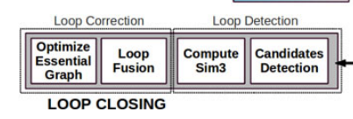
LOOP CLOSING
the last keyframe processed by the local mapping

Slide 36
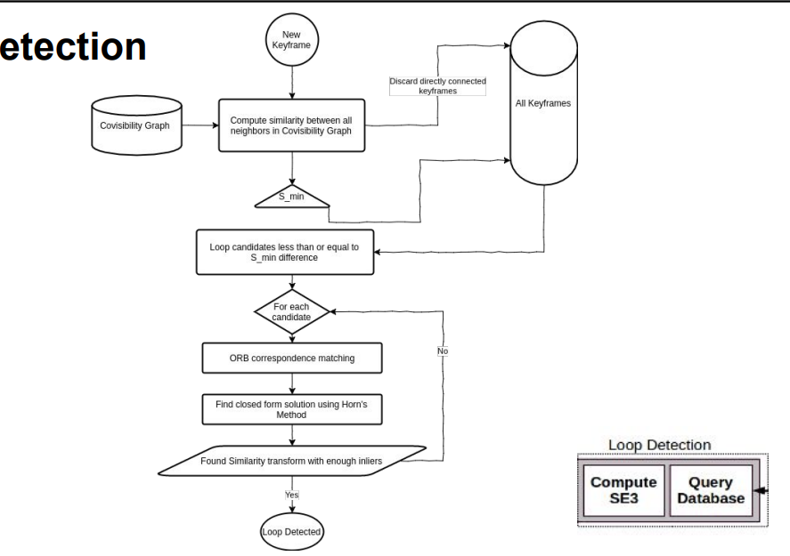
Loop Candidates Detection

Slide 37
Compute the Similarity Transformation

Slide 38
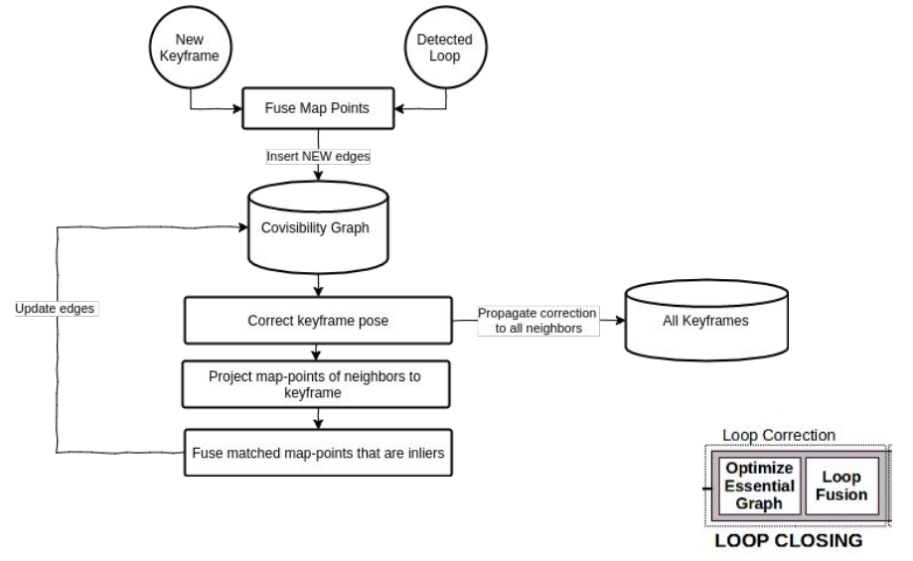
Loop Correction

